Slide 1
An Empirical Study of Training Self-Supervised Vision Transformers Kaiming He, Haoqi Fan, Yuxin Wu, Saining Xie, Ross Girshick Facebook AI Research(FAIR)

Slide 2

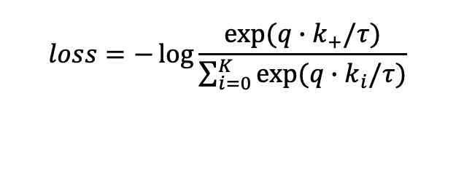





Improved
Symmetrized contrastive loss.
Remove dictionary queue.
Projection head & Prediction head.
$$loss=−\log{\frac{exp⁡(q∙k_{+}/τ)}{\sum_{i=0}^{K}{exp⁡(q∙k_{i}/τ)}}}$$
$$q=f_{q}(x^{q})$$
$q^{1},q^{2}=f_{q}\left(x^{1}\right),$ $f_{q}\left(x^{2}\right)$
$$k=f_{k}(x^{k})$$
$k^{1},k^{2}=f_{k}\left(x^{1}\right),$ $f_{k}\left(x^{2}\right)$
$$x^{k}=aug\left(x\right)$$
$$x^{q}=aug(x)$$
$$x^{1}=aug\left(x\right)$$
$$x^{2}=aug(x)$$

Slide 3
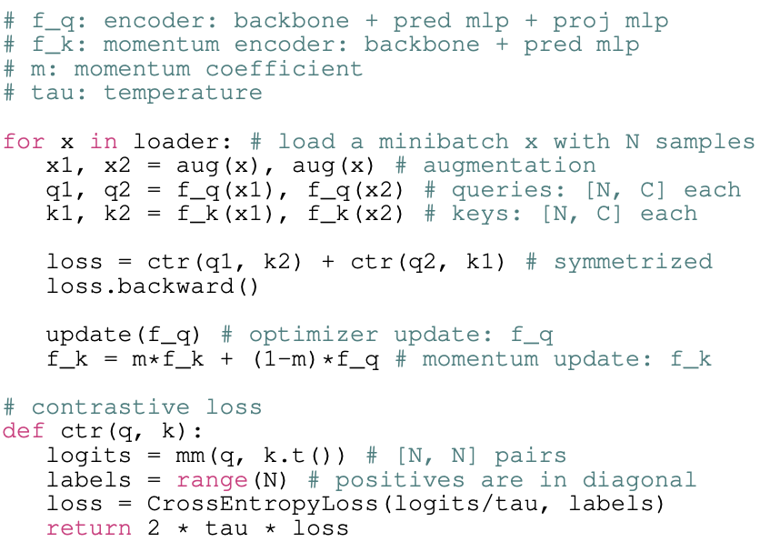
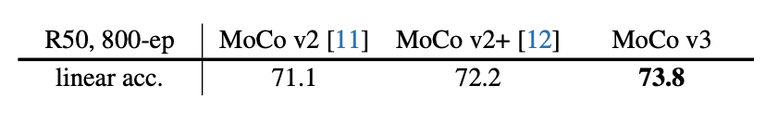
Improved
Instability in ViT (Baseline research).

Slide 4
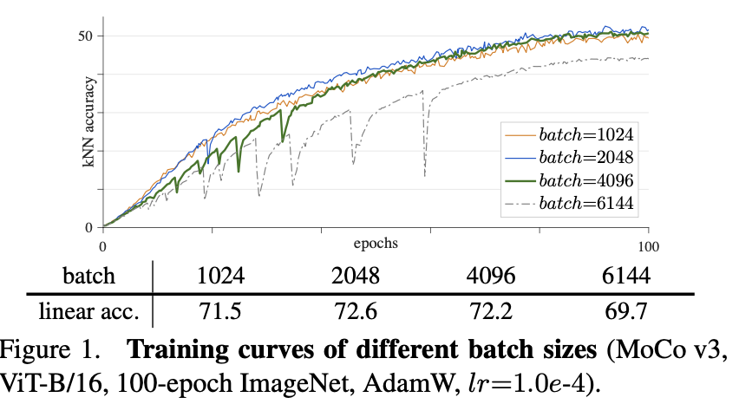
Stability-Batch Size
Large batch size brings instability(small degradation).

Slide 5
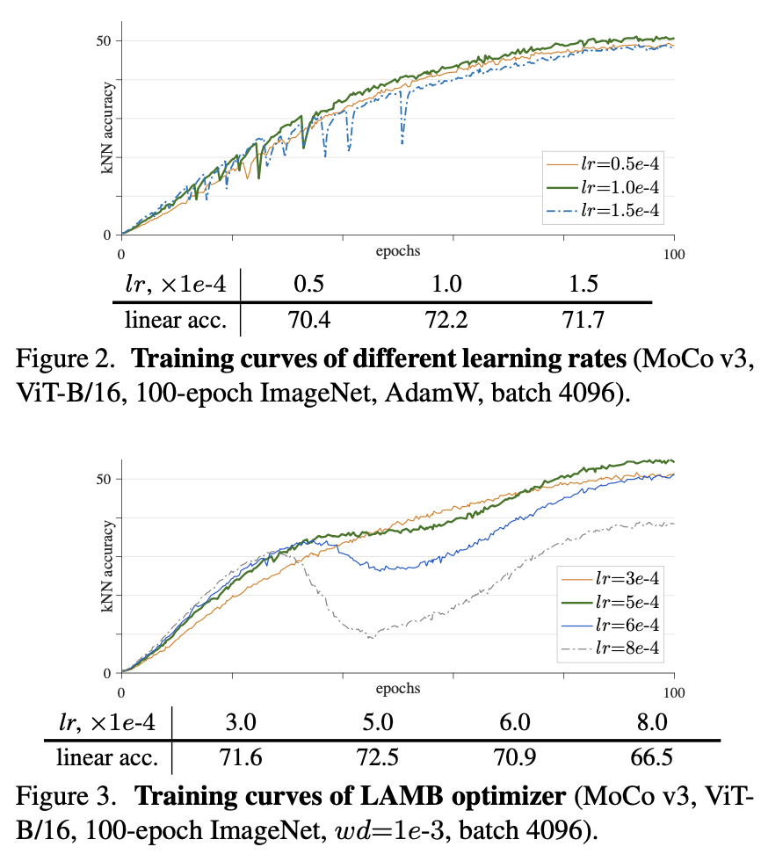
Stability-Learning Rate
AdamW is more stable .

Slide 6
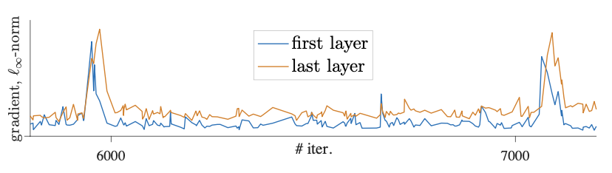
Trick to improve stability
Patch Projection leads to instability.
Use a fixed random patch projection .

Slide 7
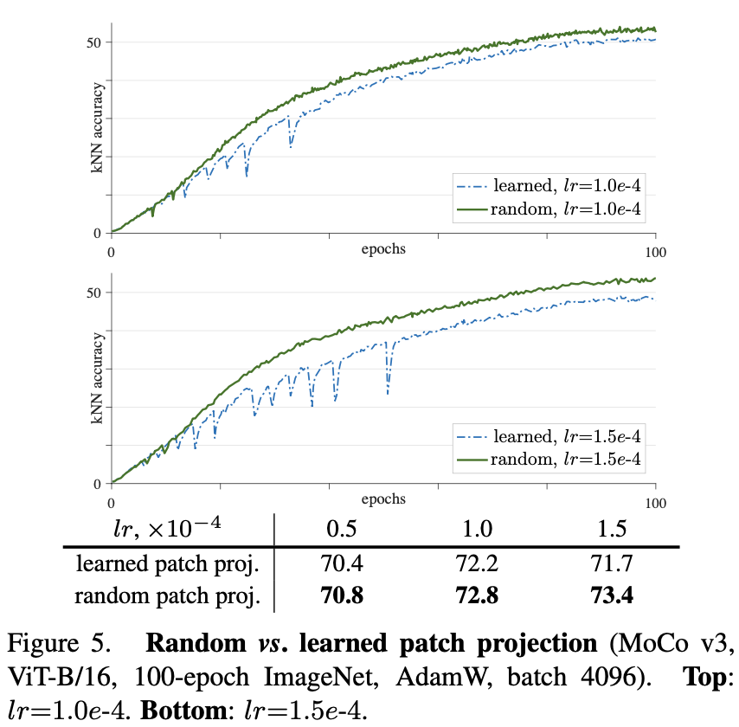
Trick to improve stability
Smoother and better result in Mocov3.

Slide 8
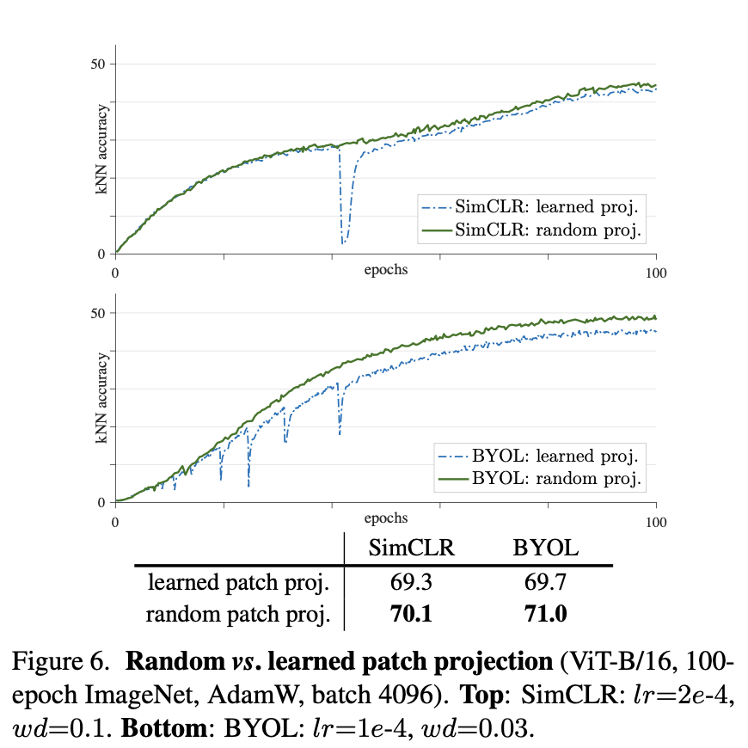
Trick to improve stability
Same result in SimCLR & BYOL.

Slide 9
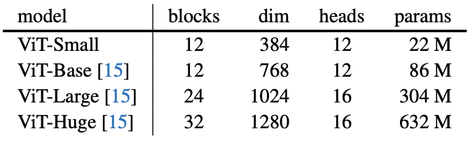
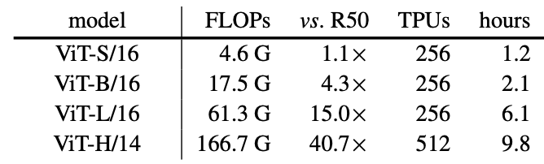
Details
Optimizer: AdamW, batchsize=4096,epoch=100
MLP: projection head 3x, prediction head 2x
ViT: patch size = (16,16) or (14,14)
Downstream: Linear pro. Remove MLP, SGD, epoch=90.

Slide 10
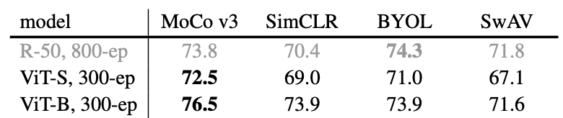
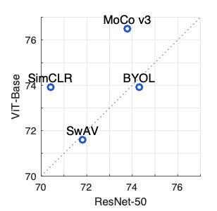
Experiment-Framwork
ResNet-50 fits with SwAV&BYOL.
ViT fits with SimCLR &MoCo v3.

Slide 11
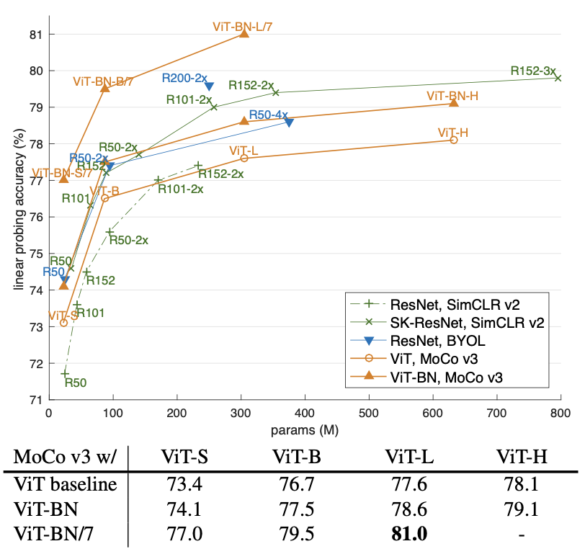
Experiment-Framwork
MoCo based ViT has better result when models
are bigger.

Slide 12
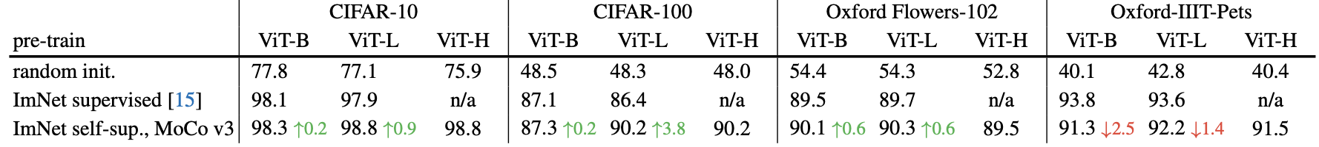
Experiment-Transfer
ViT in SSL needs more data.
Bigger ViT performs better.

Slide 13
Conclusion
ViT in SSL perform better than CNN.
ViT model should be large and need more data.
Still improvement in ViT?.
Remove position embedding only degrades accuracy by a small margin.
Patch projection?

Slide 14
Thank you (Q&A)
Notes:
RP Shortcomings：1.relative position has multi result. 2.CNN learn trivial features. 3. not whole picture.

